Slide 1
Chapter Four
Combinational
logic circuits
Under graduate (2016)
Girma Adam (M.Tech)
4.1

Slide 2
Cont’d..
Topics discussed in this section:
Introduction
Adders
Subtractors
Binary code conversion
Magnitude comparator
Decoders
Encoders
Multiplexers and Multiplexer tree
4.2

Slide 3
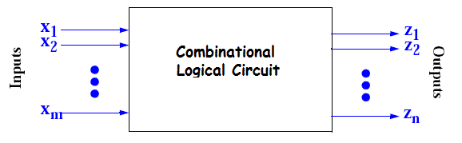
Introduction
Basically the digital Circuits are divided in to two broad categories
Combinational Circuits
Sequential Circuits
A Combinational circuits consists of logical gates whose output at any time are depending on the present combination of inputs.
A block diagram of a combinational circuit is as shown below
4.3

Slide 4
Cont’d..
The design of combinational circuits starts from the outline of the problem and ends in a logical circuit diagram, or set Boolean functions from which the logic diagram can be obtained.
The procedure involves the following steps:-
The problem is stated
The number of both input and output variables required are determined
Both input and output variables are assigned letter symbols
Te truth table that defines the required relationships between input and outputs are derived.
4.4

Slide 5
Cont’d..
The simplified Boolean function for each output is obtained.
The logic diagram is drawn.
A practical design method have to consider the following
requirements:-
1. Minimum number of gates
2. Minimum number of inputs to the gates
3. Minimum propagation delay
4. Minimum number of interconnection
5. High Speed of processing
6. Less Complexity
4.5

Slide 6
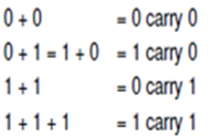
The most basic arithmetic operation is the addition of two binary digits.
This simple addition consist of four possible elementary operations
A Combinational circuits that performs the addition of two bits is
called a Half-adder.
A Combinational circuits that performs the addition of three
bits(two significant bits and a previous carry) is called Full-adder.
ADDERS
4.6

Slide 7
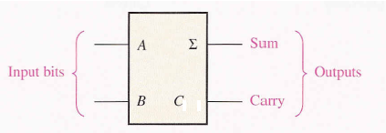
Half-adder
The half-adder can be used to add together the two least significant bits A and B of two numbers, where there is no input carry.
The block diagram of a half-adder is shown below
4.7

Slide 8
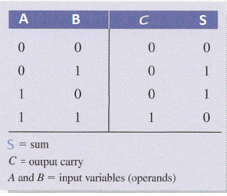
Cont,d..
Formulate a truth table to identify exactly the function of the half-adder.
The simplified Boolean functions for the two outputs can be obtained directly from the truth table.
The simplified expressions for S and C are:-
4.8

Slide 9
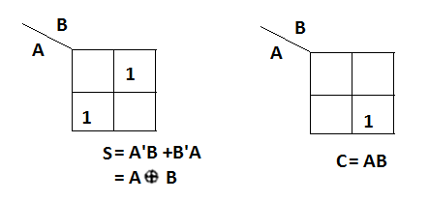
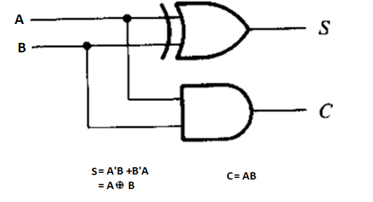
Cont’d..
4.9

Slide 10
Full-adder
A half-adder has only two inputs and there is no provision to add
a carry coming from the lower order bits when multibit addition is
performed.
For this purpose, a third input terminal is added and this circuits
(full -adder) is used to add An,Bn,Cn-1.
where
An and Bn are the n^{th} order bits of the number A and B respectively.
Cn-1 is the carry generated from the addition of (n-1) the order bits
4.10

Slide 11
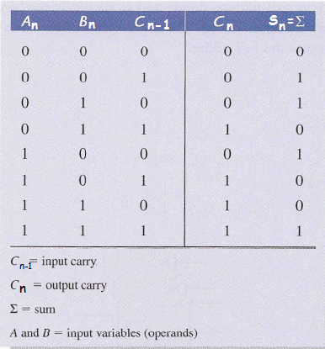
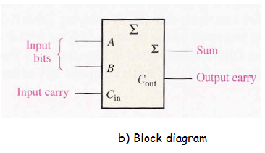
Cont,d..
The truth table of full-adder and the k-map for simplification of
outputs Sn and Cn are given below
4.11

Slide 12
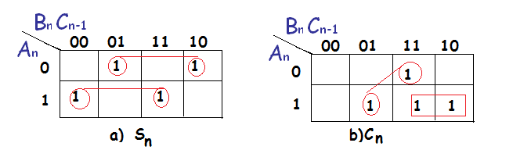
Cont’d..
This implementation uses the following Boolean expressions
4.12

Slide 13
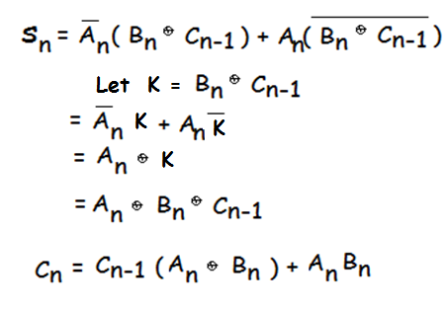
Cont’d...
The Sn output from the second half-adder is the exclusive-OR of Cn-1 and the output of the first half-adder, giving
Carry
4.13

Slide 14
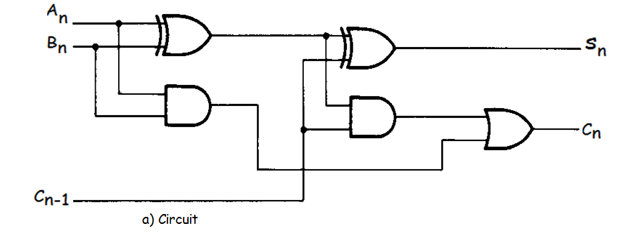
Cont’d...
4.14

Slide 15
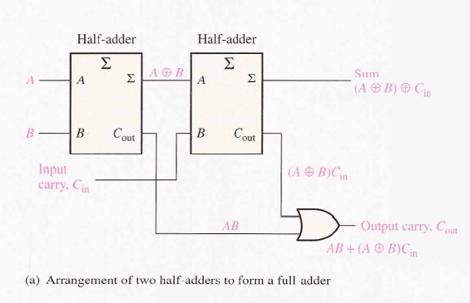
Full-adder from half-adders
4.15

Slide 16
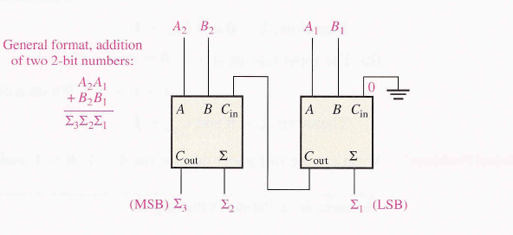
Parallel adder
Two or more full-adders are connected to form parallel binary adders.
The carry output signal from one stage propagates to the carry input of the next stage
4.16

Slide 17
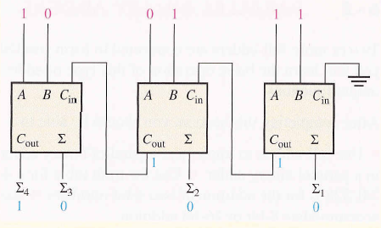
Cont,d..
Example.1:- Determine the sum generated by the 3-bit parallel adder and show the intermediate carriers when the binary number 101 and 011 are being added ?
Solution
4.17

Slide 18
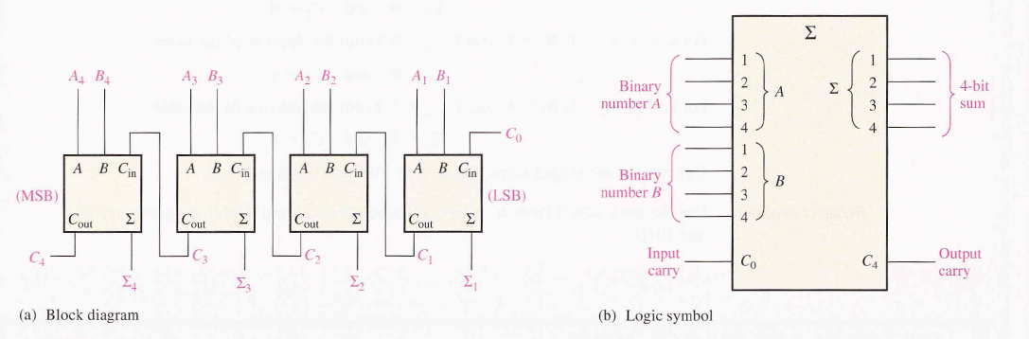
A 4-bit parallel binary adder
Exercise 1:- Show how adders can be connected to form an 8-bit parallel adder, and show the output bits for the following input binary numbers ? 10111001 and 10011110
4.18

Slide 19
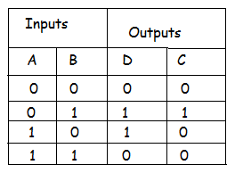
Subtractors
Half-Subtractor:- a logical circuit for the subtraction of B from A, where A and B are 1-bit numbers is referred to as a half-Subtractor.
The truth table of half-Subtractor is :-
Here A and B are two inputs and D (difference) and C(borrow) are the two outputs
4.19

Slide 20
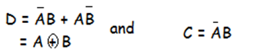
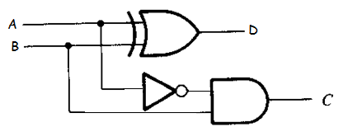
Cont’d...
From the truth table, the logical expression for D and C are obtained
The logical diagram of half-Subtractor using gates is shown below
4.20

Slide 21
Cont’d..
Full-Subtractor:- Just like a full-adder we require a full-Subtractor for performing multi bit subtraction ,
A full-Subtractor will have three inputs, An ,Bn and Cn-1 (borrow from the previous stage) and two out puts Dn (difference) and Cn (borrow).
The truth table of Full-subtractor is :-
4.21

Slide 22
Cont’d..
The truth table of full-Subtractor and the k-map for simplification of
outputs Dn and Cn are given below
Inputs |  |  | Outputs
An | Bn | Cn1 | Dn | Cn
0 | 0 | 0 | 0 | 0
0 | 0 | 1 | 1 | 1
0 | 1 | 0 | 1 | 1
0 | 1 | 1 | 0 | 1
1 | 0 | 0 | 1 | 0
1 | 0 | 1 | 0 | 0
1 | 1 | 0 | 0 | 0
1 | 1 | 1 | 1 | 1
4.22

Slide 23
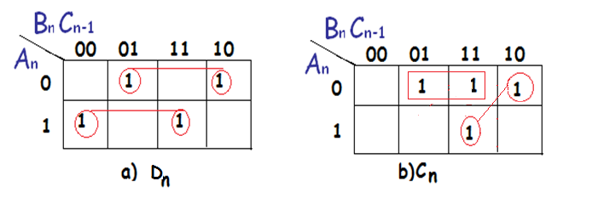
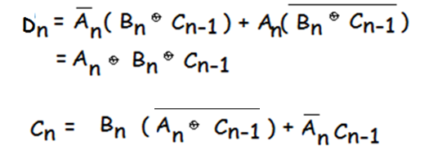
Cont’d..
This implementation uses the following Boolean expressions
4.23

Slide 24
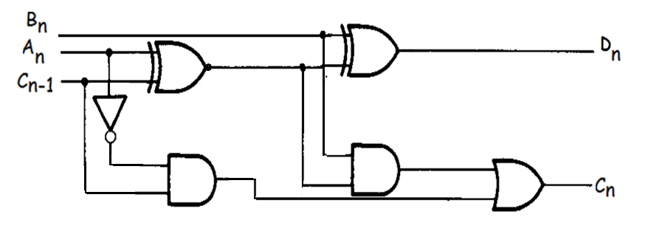
Cont’d..
The full – Subtractor logic Circuit diagram
4.24

Slide 25
Binary Subtractor using 2’s complement
The Subtrcation A – B can be done by taking the 2’s complement of B and adding it to A because A- B = A + (-B) = A+2’sB.
It means if we use the inverters to make 1’s complement of B (connecting each Bi to an inverter) and then add 1 to the least significant bit (by setting carry C0 to 1) of binary adder, then we can make a binary subtractor.
4.25

Slide 26
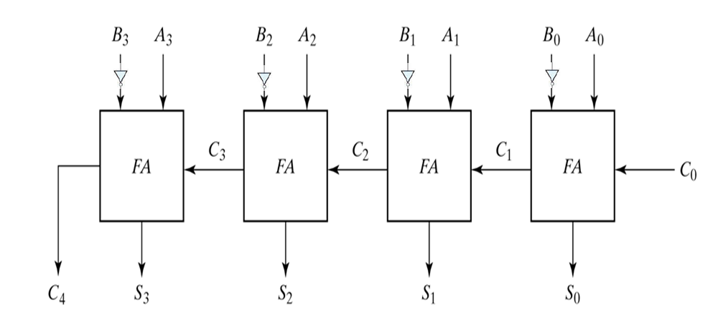
4 bit 2’s complement Subtractor
4.26

Slide 27
Binary Conversion
The availability of a large variety of codes for the same discrete elements of information results in the use of different codes by different digital systems.
It is sometimes necessary to use the output of one system as input to another , at this condition a conversion circuit is inserted between the two systems, if each uses different codes for the same information.
Thus a code converter is a circuit that makes the two systems compatible even though each system uses a different binary code.
4.27

Slide 28
Cont’d..
The design procedure of code converters will be illustrated by means of a specific examples:-
Binary to Gray code converter
The truth table of a 4-bit binary to gray code converter is given below:-
Binary codes |  |  |  | Gray codes
B3 | B2 | B1 | B0 | G3 | G2 | G1 | G0
0 | 0 | 0 | 0 | 0 | 0 | 0 | 0
0 | 0 | 0 | 1 | 0 | 0 | 0 | 1
0 | 0 | 1 | 0 | 0 | 0 | 1 | 1
0 | 0 | 1 | 1 | 0 | 0 | 1 | 0
4.28

Slide 29
Cont’d..
Binary codes |  |  |  | Gray codes
B3 | B2 | B1 | B0 | G3 | G2 | G1 | G0
0 | 1 | 0 | 0 | 0 | 1 | 1 | 0
0 | 1 | 0 | 1 | 0 | 1 | 1 | 1
0 | 1 | 1 | 0 | 0 | 1 | 0 | 1
0 | 1 | 1 | 1 | 0 | 1 | 0 | 0
1 | 0 | 0 | 0 | 1 | 1 | 0 | 0
1 | 0 | 0 | 1 | 1 | 1 | 0 | 1
1 | 0 | 1 | 0 | 1 | 1 | 1 | 1
1 | 0 | 1 | 1 | 1 | 1 | 1 | 0
1 | 1 | 0 | 0 | 1 | 0 | 1 | 0
1 | 1 | 0 | 1 | 1 | 0 | 1 | 1
1 | 1 | 1 | 0 | 1 | 0 | 0 | 1
1 | 1 | 1 | 1 | 1 | 0 | 0 | 0
4.29

Slide 30
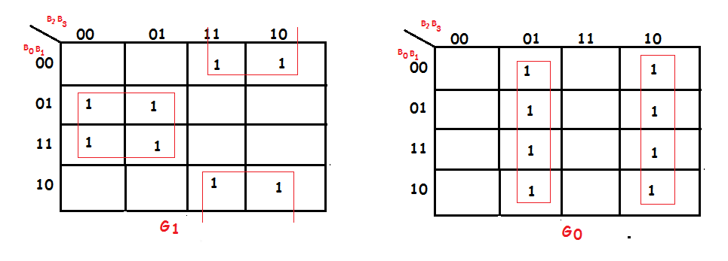
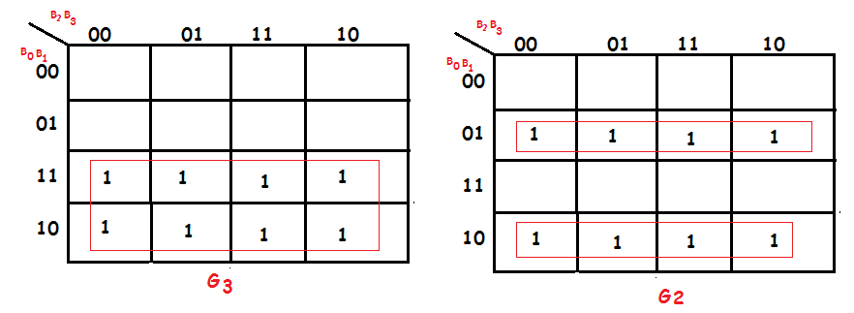
Cont’d..
4.30

Slide 31
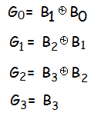
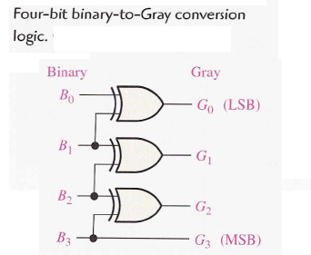
Cont’d..
This implementation uses the following Boolean expressions
4.31

Slide 32
Cont’d..
2. Gray to Binary code converter
The truth table of a 4-bit Gray to binary code converter is given
below:-
Gray codes |  |  |  | Binary codes
G3 | G2 | G1 | G0 | B3 | B2 | B1 | B0
0 | 0 | 0 | 0 | 0 | 0 | 0 | 0
0 | 0 | 0 | 1 | 0 | 0 | 0 | 1
0 | 0 | 1 | 1 | 0 | 0 | 1 | 0
0 | 0 | 1 | 0 | 0 | 0 | 1 | 1
4.32

Slide 33
Cont’d..
Gray codes |  |  |  | Binary codes
G3 | G2 | G1 | G0 | B3 | B2 | B1 | B0
0 | 1 | 1 | 0 | 0 | 1 | 0 | 0
0 | 1 | 1 | 1 | 0 | 1 | 0 | 1
0 | 1 | 0 | 1 | 0 | 1 | 1 | 0
0 | 1 | 0 | 0 | 0 | 1 | 1 | 1
1 | 1 | 0 | 0 | 1 | 0 | 0 | 0
1 | 1 | 1 | 1 | 1 | 0 | 0 | 1
1 | 1 | 1 | 0 | 1 | 0 | 1 | 0
1 | 0 | 1 | 0 | 1 | 0 | 1 | 1
1 | 0 | 1 | 1 | 1 | 1 | 0 | 0
1 | 0 | 1 | 1 | 1 | 1 | 0 | 1
1 | 0 | 0 | 1 | 1 | 1 | 1 | 0
1 | 0 | 0 | 0 | 1 | 1 | 1 | 1
4.33

Slide 34
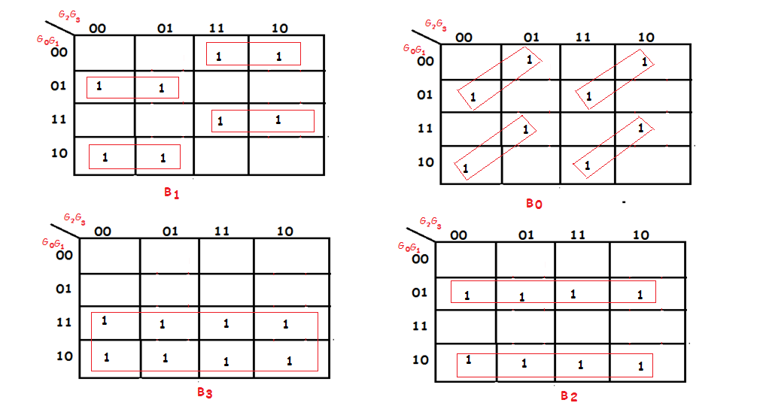
Cont’d..
4.34

Slide 35
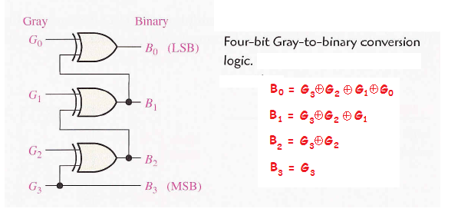
Cont’d..
This implementation uses the following Boolean expressions
and logic diagram
4.35

Slide 36
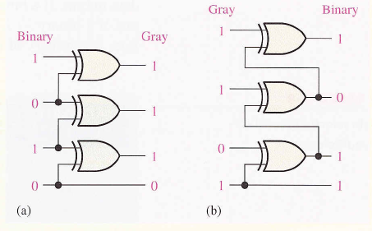
Cont’d..
Exercise
Convert the binary number 0101 to Gray code with
exclusive –OR gates
2. Convert the Gray code 1011 to binary with
exclusive –OR gates
Solution
4.36

Slide 37
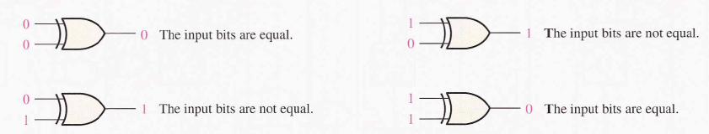
Magnitude comparator
A magnitude comparator is a combinational circuit that compares
two numbers A and B, and determines their relative magnitudes.
The outcome of the comparison is specified by three binary
variables that indicate whether A> B, A=B or A<B.
Exclusive-OR gate can be used as a basic comparator
Equality
Exclusive-OR gate as 1-bit comparator
4.37

Slide 38
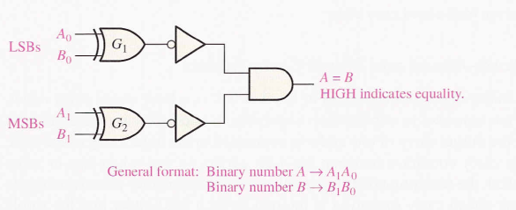
Cont’d..
Exclusive-OR gate as 2-bit comparator
The output is 1 when Ao=Bo and A1=B1,
4.38

Slide 39
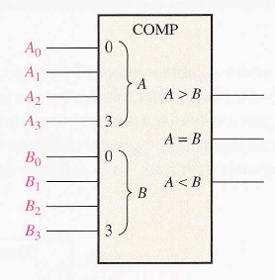
Cont’d..
Exclusive-OR gate as 4-bit comparator
Detects one of three conditions
Only one output will be High at any one time
- A greater than B (A > B)
- A equal to B (A = B)
- A less than B (A < B)
4.39

Slide 40
Cont’d..
The two numbers will be equal if all pairs of significant digits
are equal, that is, A3 = B3, A2 = B2,A1 = B1 and A0 = B0.
To determine an inequality of binary number A and B, starting from the most significant position in each number. The following condition are possible
1. If A3 = 1 and B3 = 0 , number A > B
2. If A3 = 0 and B3 = 1, number A <B
3. If A3 = B3 , then you must examine the next lower bit position for an inequality.
The comparison continues until a pair of unequal digits is reached.
4.40

Slide 41
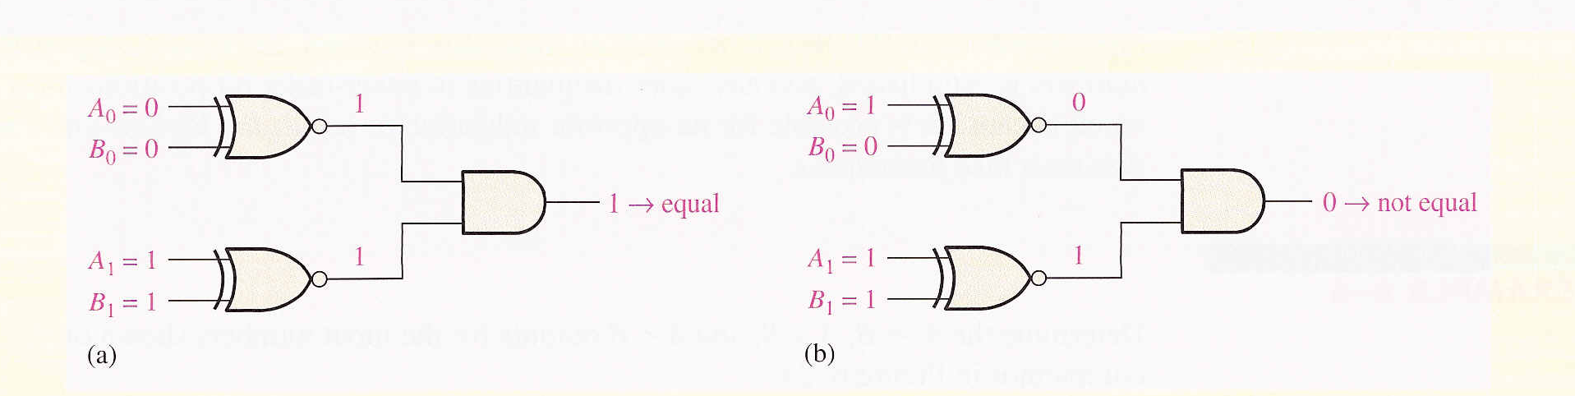
Cont’d..
Example:- Apply each of the following sets of binary numbers to the comparator circuit and determine the output by following the logical levels through the circuit
a) 10 and 10 b) 11 and 10
Solution
4.41

Slide 42
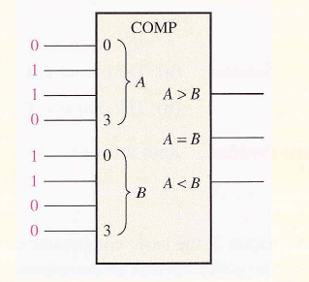
Cont’d..
Example:- Determine the A=B, A >B and A < B outputs for the
input numbers shown on the comparator circuit ?
Solution
The number A is greater than B, A > B output is high and the other output are low
4.42

Slide 43
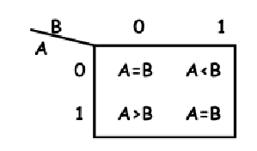
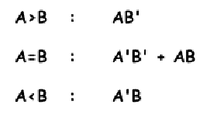
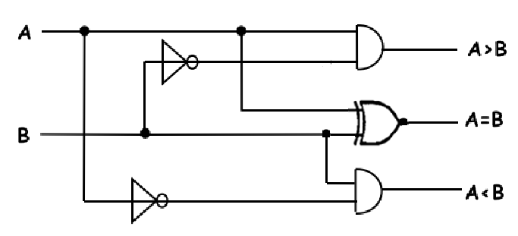
Designing Comparators Functionally
One bit comparator
4.43

Slide 44
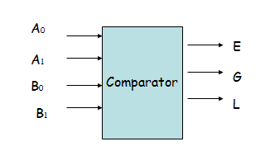
Cont’d..
Design a comparator for 2 bit binary numbers A
(A1A0) and B (B1B0) we do the following steps:
For a 2-bit comparator we have four inputs A1A0 and B1B0 and three output
1. E ( is 1 if two numbers are equal)
2. G (is 1 when A > B) and
3. L (is 1 when A < B)
The circuit, for comparing two n-Bit numbers, has 2n inputs &
2^{2n} entries in the truth table.
For 2-Bit numbers, 4-inputs & 16-rows in the truth table.
4.44

Slide 45
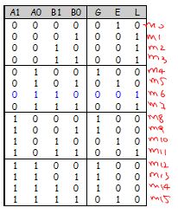
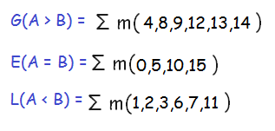
Cont’d..
Truth Table of 2-Bit Magnitude Comparator
4.45

Slide 46
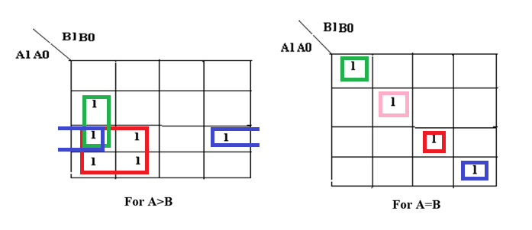
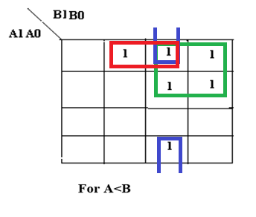
Cont’d..
4.46

Slide 47
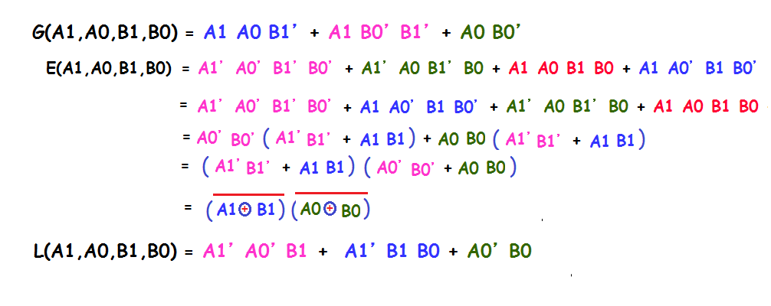
Cont’d..
4.47

Slide 48
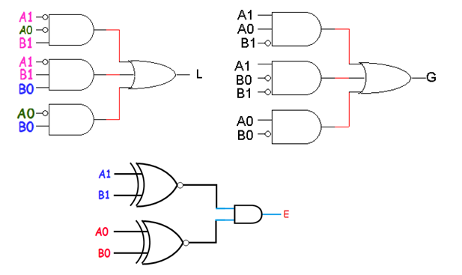
Cont’d..
4.48

Slide 49
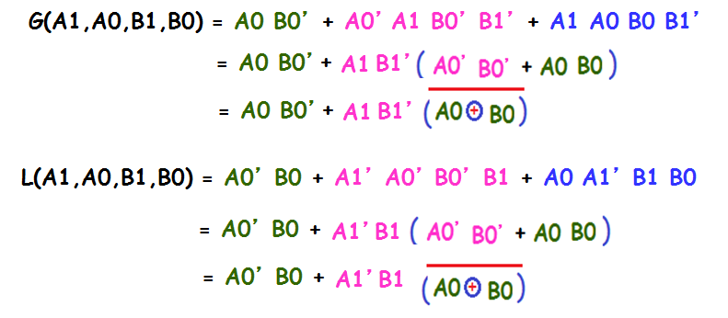
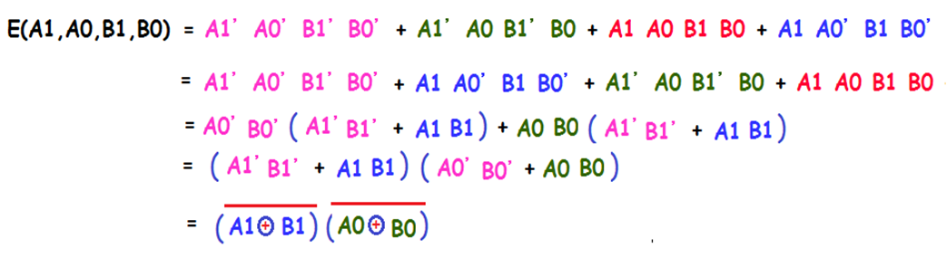
Cont’d..
4.49

Slide 50
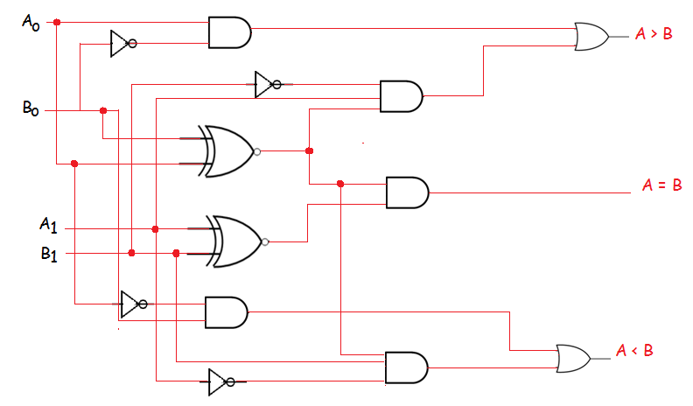
Combined
4.50

Slide 51
Decoder
A decoder is a combinational logic circuit that accepts a set of inputs that represents a binary number and activates only the output that corresponds to the input number.
In its general form, a decoder has n input lines to handle n bits and form one to 2 ^{n} output lines to indicate the presence of one or more n-bit combinations.
The decoder presented here are called n-to-m line decoders where m ≤ 2^{n} .
The general Block diagram of a Decoder circuit
4.51

Slide 52
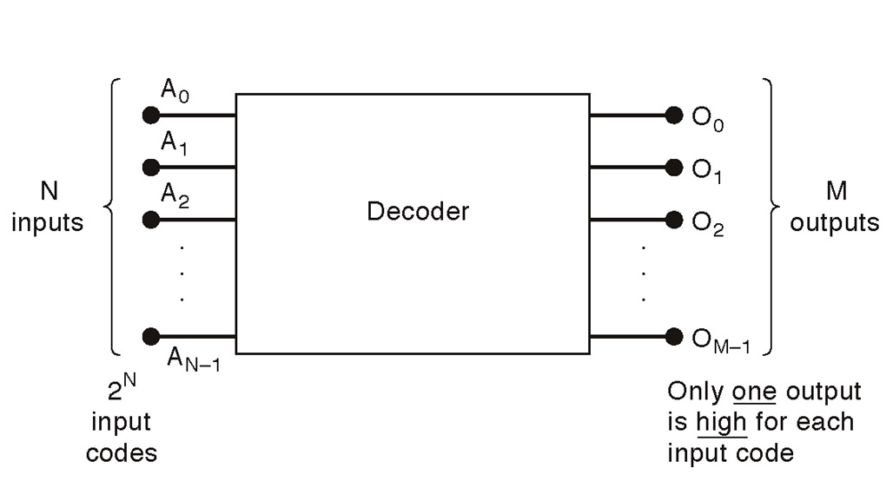
Cont’d..
# There are 2^{N} possible input combinations, from A₀ to A_{N−1}.
For each of these input combinations only one of the M outputs will be active HIGH (1), all the other outputs are LOW (0).
4.52

Slide 53
Cont’d..
The basic binary function
If an active-LOW output (74138, one of the output will low and the rest will be high) is required for each decoded number, the entire decoder can be implemented with
NAND gates
Inverters
If an active-HIGH output (74139, one of the output will high and the rest will be low) is required for each decoded number, the entire decoder can be implemented with
AND gates
Inverters
4.53

Slide 54
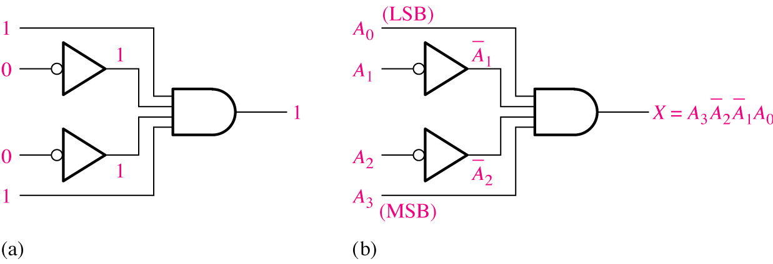
Cont’d..
Example: 1 Decoding logic for the binary code 1001 with an
active-HIGH output.
Solution
4.54

Slide 55
Decoder with Enable Line
Decoders usually have an enable line,
Enabling permits an input signal to pass through to an output
Disabling blocks an input signal from passing through to an output, replacing it with a fixed value.
If enable=0 , decoder is off. It means all output lines are zero
If enable=1, decoder is on and depending on input, the corresponding output line is 1, all other lines are 0
4.55

Slide 56
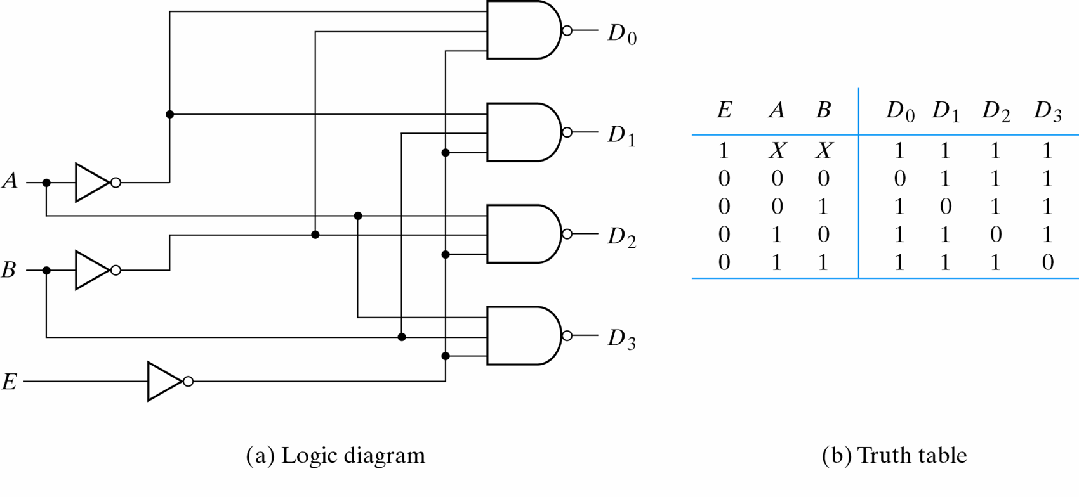
Cont’d..
Example.2: 2-to-4 line decoder (with enable input)-active
Low output
Solution
4.56

Slide 57

Cont’d..
For example if the number of input is n=3 the number of output lines can be m=2³ . It is also known as 1 of 8 because one output line is selected out of 8 available lines:
The decoder presented here are called n-to-m line decoders where m ≤ 2^{n}
4.57

Slide 58

Cont’d..
Their purpose is to generate the 2^{n} or less minterms of n input variables.
Consider the 3-to-8 line decoder , the three inputs are decoded in to eight outputs, each output representing one of the minterms of the 3-input variables.
4.58

Slide 59

Cont’d..
The truth table of a 3-to-8 line decoder
4.59

Slide 60

Cont’d..
4.60

Slide 61

Cont’d…
This binary port address is decoded and the appropriate decoder output is activated to enable the I/O port.
4.61

Slide 62

BCD-to-Decimal Decoder
The elements of information in this case are the ten decimal digits represented by the BCD code.
The code itself has four bits
This will gives a 4-to-10 line BCD –to-decimal decoder.
4.62

Slide 63
Cont’d..
The truth table of BCD –to-Decimal decoder
inputs |  |  |  |  | outputs
A3 | A2 | A1 | A0 | D0 | D1 | D2 | D3 | D4 | D5 | D6 | D7 | D8 | D9
0 | 0 | 0 | 0 | 1 | 0 | 0 | 0 | 0 | 0 | 0 | 0 | 0 | 0
0 | 0 | 0 | 1 | 0 | 1 | 0 | 0 | 0 | 0 | 0 | 0 | 0 | 0
0 | 0 | 1 | 0 | 0 | 0 | 1 | 0 | 0 | 0 | 0 | 0 | 0 | 0
0 | 0 | 1 | 1 | 0 | 0 | 0 | 1 | 0 | 0 | 0 | 0 | 0 | 0
0 | 1 | 0 | 0 | 0 | 0 | 0 | 0 | 1 | 0 | 0 | 0 | 0 | 0
0 | 1 | 0 | 1 | 0 | 0 | 0 | 0 | 0 | 1 | 0 | 0 | 0 | 0
0 | 1 | 1 | 0 | 0 | 0 | 0 | 0 | 0 | 0 | 1 | 0 | 0 | 0
0 | 1 | 1 | 1 | 0 | 0 | 0 | 0 | 0 | 0 | 0 | 1 | 0 | 0
1 | 0 | 0 | 0 | 0 | 0 | 0 | 0 | 0 | 0 | 0 | 0 | 1 | 0
1 | 0 | 0 | 1 | 0 | 0 | 0 | 0 | 0 | 0 | 0 | 0 | 0 | 1
4.63

Slide 64

Cont’d..
4.64

Slide 65

BCD-7segment decoders/drivers
Most digital equipment has some means for displaying information
in a form that can be understood by the user. This information is
often numerical data but also be alphanumeric.
One of the simplest and most popular methods for displaying
numerical digits uses a 7-segment configuration to form digital
characters 0 to 9 and some times the hex characters A to F
4.65

Slide 66

Cont’d..
One common arrangements uses light-emitting diodes (LED's) for
each segment. By controlling the current through each LED, some
segments will be light and others will be dark so that desired
character pattern will be generated.
There are two types of 7−segment LED displays;
A) common - anode
B) common − cathode
4.66

Slide 67


Cont’d..
In common−anode, the anode of all of the LEDs are tied together to
positive of the power supply (V_{cc}) as shown
4.67

Slide 68

Cont’d..
4.68

Slide 69

Cont’d..
Example: 1
4.69

Slide 70

Cont’d..
4.70

Slide 71

Cont’d..
In common cathode, the cathode of all of the LEDs are tied together to positive of the power supply (V_{cc}) as shown
4.71

Slide 72

Cont’d..
4.72

Slide 73

Cont’d..
4.73

Slide 74

Cont’d..
4.74

Slide 75
Cont’d..
a = A + B D + C + B' D'
b = C' D' + C D + B'
c = B + C' + D
d = B' D' + C D' + B C' D + B' C + A
e = B' D' + C D’
f = A + C' D' + B D' + B C'
g = A + C D' + B C' + B' C
4.75

Slide 76

Cont’d..
4.76

Slide 77

Cont’d..
4.77

Slide 78
Cont’d..
Example.1. Design and implement a logic diagram for a Boolean function given by a truth table below using a 3-to-8 decoder
Truth table:
Solution
Minterms:
F=Σm(3,5,6,7)
Implementation using decoder:
A B C F
0 0 0 0
0 0 1 0
0 1 0 0
0 1 1 1
1 0 0 0
1 0 1 1
1 1 0 1
1 1 1 1
Indicate MSB, LSB
A
B
C
0
1
2
3
4
5
6
7
2
1
0
F
4.78

Slide 79

Cont’d..
Example.2.Can you design and implement a Boolean Function given below using a 2-to-4 decoder with enable input and an OR gate?
Solution
Yes, Using a 2-to-4 decoder with enable input and an OR gate:
F=C(AB+A’B’)
F=C(AB+A’B’) = ABC + A’B’C
EN
4.79

Slide 80

Cont’d..
Example.3. a 7-segment decoder drives the display in figure below. If the waveforms given below are applied as input, determine the sequence of digits that appears on the display ?
Solution
4.80

Slide 81
Encoder
An encoder is a combinational logic circuit that essentially performs a ‘’ reverse’’ process of decoder function.
Encoders can encode various symbols and alphabetic characters.
The process of converting from familiar symbols or number to a coded format is called encoding.
An encoder accepts an active level on one of its inputs representing a digit, such as a decimal or octal and converts it to a coded output, such as BCD or Binary
4.81

Slide 82

Cont’d..
4.82

Slide 83

Decimal-to-BCD encoder
A decimal-to-BCD encoder
Inputs: 10 bits corresponding to decimal digits 0 through 9, (D₀, …, D₉)
Outputs: 4 bits with BCD codes
Function: If input bit Di is a 1, then the output (A₃, A₂, A₁, A₀) is the BCD code for i,
4.83

Slide 84


Cont’d..
4.84

Slide 85

Cont’d..
The Boolean Equation can be :-
A3 = D8 + D9
A2 = D4 + D5 + D6 + D7
A1 = D2 + D3 + D6 + D7
A0 = D1 + D3 + D5 + D7 + D9
4.85

Slide 86
Multiplexer & Multiplexer tree
It is a combinational circuit that selects binary information from one of the input lines and directs it to a single output line
Usually there are 2^{n} input lines and n selection lines whose bit combinations determine which input line is selected
Depending upon the digital code applied at the selector inputs one out of n data source is selected and transmitted to a single output channel.
4.86

Slide 87

Cont’d..
4.87

Slide 88

Cont’d..
MUX Types
2-to-1 (1 select line)
4-to-1 (2 select lines)
8-to-1 (3 select lines)
16-to-1 (4 select lines)
4.88

Slide 89

Typical Application of a MUX
4.89

Slide 90

Cont’d..
4.90

Slide 91

Cont’d..
For example for 2-to-1 multiplexer
1. if selection S is zero then I₀ has the path to output and
2. if S is one I₁ has the path to output
4.91

Slide 92


Cont’d..
Truth table for 2-to-1 multiplexer
For 4-to-1 multiplexer
4.92

Slide 93

Cont’d..
Truth table for 4-to-1 multiplexer
Derive the logical expression for the output in terms of the
data input and the select line
The output is equal to Do only if S1 = 0 and So = 0 : Y=DoS1So
The output is equal to D1 only if S1 = 0 and So = 1 : Y=D1S1So
The output is equal to D2 only if S1 = 1 and So = 0 : Y=D2S1So
The output is equal to D3 only if S1 = 1 and So = 1 : Y=D3S1So
4.93

Slide 94


Cont’d..
The Boolean expression of the input selected (y)
The logic diagram of 4-to-1 multiplexer
4.94

Slide 95


Cont’d..
Example.1. the data input and data-select waveforms in figure below are applied to the 4-to-1 multiplexer. Determine the output waveform in relation to the inputs ?
Solution
4.95

Slide 96

Multiplexer tree
Pin diagram and logical symbol for the 74LS151 8-input data
selector/multiplexer.
A LOW on the Enable input allows the selected input data to pass through to the output. A HIGH on the Enable input prevents data from going through to the output; i.e, it disables the multiplexer.
4.96

Slide 97

Cont’d..
Example.1. Design 16:1 multiplexer using 8:1 multiplexer ?
Solution
Exercise.1. Design 32:1 multiplexer using 8:1 and 4:1 multiplexer ?
4.97

Slide 98
Boolean function Implementation
The multiplexing function can conveniently be used as a logic
element in the design of combinational circuits.
For using the multiplexer as a logic element, either the truth
table or one of the standard forms of logical expression must be
available.
The design procedure is given below
Identify the decimal number corresponding to each minterm in the expression.
The input lines corresponding to these numbers are to be connected to logic 1 level.
All other input lines are to be connected to logic o level.
The inputs are to be applied to select inputs
4.98

Slide 99

Cont’d..
Example.1. Implement the logic function specified in truth table below by using a 74LS151 8-input data selector/multiplexer. Compare this method with a discrete logic gate implementation
Solution Y =Σm(1,3,5,6)
4.99

Slide 100

Cont’d..
4.100

Slide 101
Cont’d..
Another method for implementing Boolean function is using multiplexer
For doing that assume Boolean function has n variables. We have to use multiplexer with n-1 selection lines and
1- first n-1 variables of function is used for data input
2- the remaining single variable ( named z )is used for data input.
Each data input can be z, z’, 1 or 0. From truth table we have to find the relation of F and z to be able to design input lines.
4.101

Slide 102

Cont’d..
Example.1. : f(A,B,C,D) = ∑(1,3,4,11,12,13,14,15)
Solution
4.102

Slide 103

Cont’d..
Example.2.: Implement the logic function in truth table below by using 74LS151 8-input data selector/multiplexer. Compare this method with a discrete logic gate ?
4.103

Slide 104

Cont’d..
Solution
4.104

Slide 105

Demultiplexer
A demultiplexer basically reverse the multiplexing function. It takes digital information from one line and distributes it to a given number of outputs. For this reason the demultiplexer is also know as data distributor.
4.105

Slide 106

Cont’d..
DEMUX Types
1-to-2 (1 select line)
1-to-4 (2 select lines)
1-to-8 (3 select lines)
1-to-16 (4 select lines)
4.106

Slide 107

Typical Application of a DEMUX
4.107

Slide 108

Cont’d..
For example for 1-to-4 De-Multiplexer (DEMUX)
4.108

Slide 109


Cont’d..
Example.1. The serial data-input wave form(data in) and data-select inputs (So and S1) are as shown below. Determine the data-output waveforms for the 1-to-4 demultiplexer ?
Solution
4.109

